Slide 1
Secure Data Hiding In Images Using Steganography
CAPSTONE PROJECT
Presented By: Deeksha J
Student Name : Deeksha J
College Name & Department : SJB Institute of Technology & Computer Science and Engineering

Slide 2
OUTLINE
Problem Statement
Technology used
Wow factor
End users
Result
Conclusion
Git-hub Link
Future scope

Slide 3
Problem Statement
🔹 Digital security is crucial, but images are often neglected in encryption techniques. 🔹 Traditional encryption focuses mainly on text data, leaving images vulnerable to theft. 🔹 Our project provides a secure way to encrypt and decrypt images using passwords. 🔹 This ensures that only authorized users can access hidden information.

Slide 4
Technology used
🛠 Programming Language: Python 🖥 Frontend: HTML, CSS (Dark Theme), JavaScript 🔗 Backend: Flask
💻Platform: Windows 11 📦 Libraries Used: ✅ OpenCV – Image Processing ✅ NumPy – Array Manipulation ✅ Flask – Web Server

Slide 5
Wow factors
🔥 Password-Based Image Encryption – Users can encrypt images with a custom password, preventing unauthorized access. 🔥 Data Hidden Inside Image Pixels – Encryption stores message directly in image pixels, making it hard to detect. 🔥 Modern Dark-Themed UI – Provides a sleek, visually appealing dark mode interface. 🔥 Works on Any Device – Accessible via any browser with no installation required. 🔥 Instant Encryption & Decryption – Real-time processing ensures quick and secure image protection.

Slide 6
End users
🎯 Who Can Use This? ✅ Individuals – Protect private photos & personal data. ✅ Organizations – Encrypt sensitive documents like ID scans, legal papers, and medical records. ✅ Cybersecurity Enthusiasts – Learn about image-based encryption techniques. ✅ Developers & Researchers – Use as a base for advanced encryption projects.

Slide 7
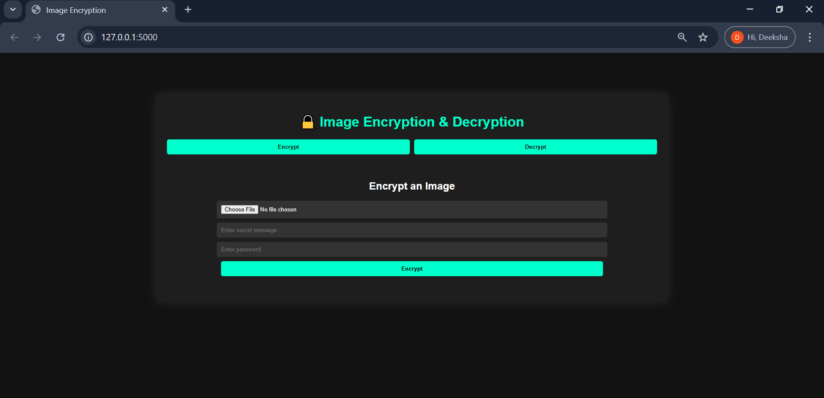
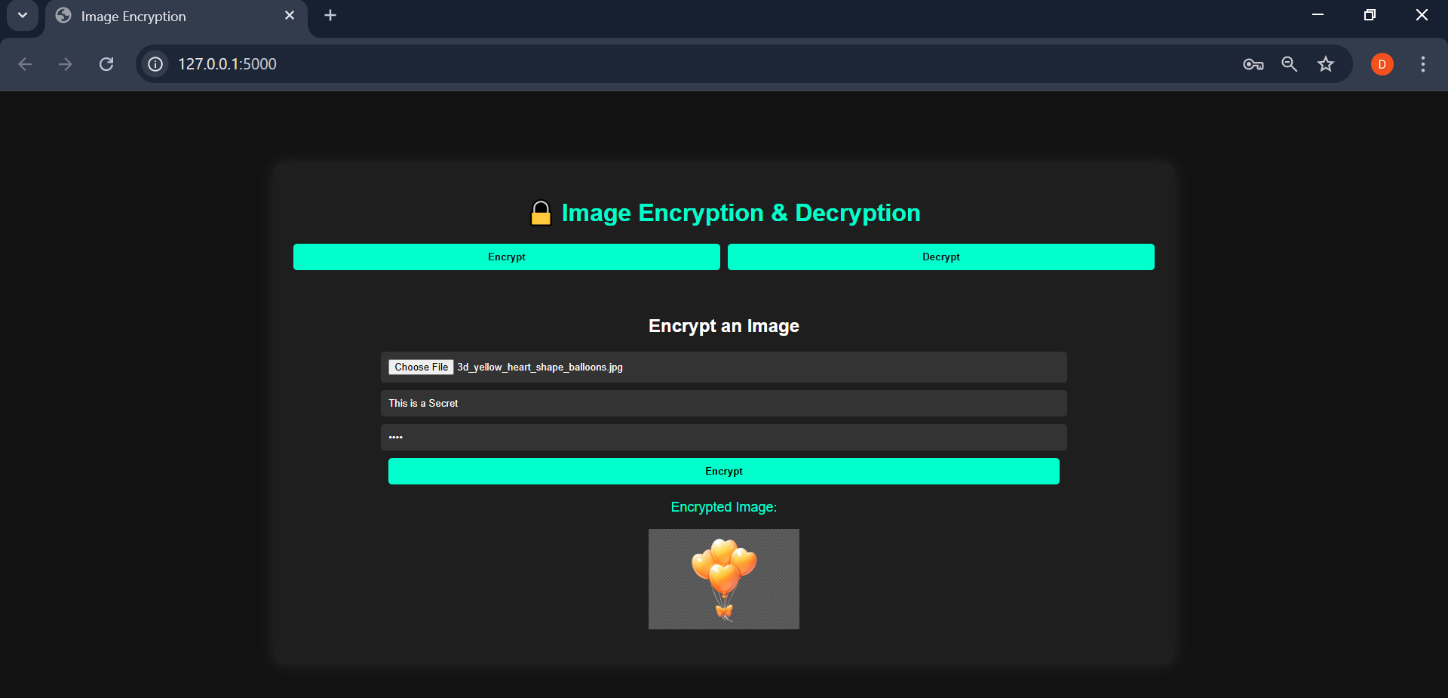
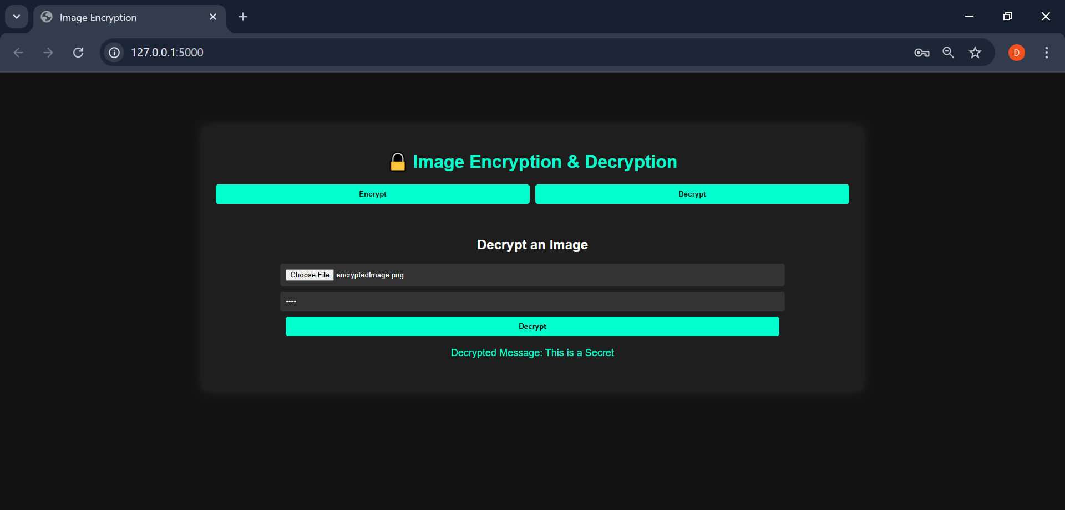
Results
1️⃣ Uploading an Image for Encryption 2️⃣ Encrypted Image Output (showing encryption applied) 3️⃣ Decryption & Displaying the Hidden Message

Slide 8
Conclusion
✔ Successfully encrypts and decrypts images using password protection. ✔ Provides a secure way to store secret messages inside images. ✔ Ensures easy and intuitive access through a modern web-based UI. ✔ A step forward in securing digital media from unauthorized access.

Slide 9
GitHub Link
https://github.com/Deekshagj/PixelCipher.git

Slide 10
Future scope(optional)
🚀 Planned Enhancements: 🔹 AES Encryption Integration for military-grade security. 🔹 Cloud Storage Support – Securely store & retrieve encrypted images online. 🔹 Steganography Feature – Hide secret messages inside normal-looking images. 🔹 Mobile App Version – Encrypt & decrypt images directly from a smartphone.

Slide 11
THANK YOU

